Slide 1


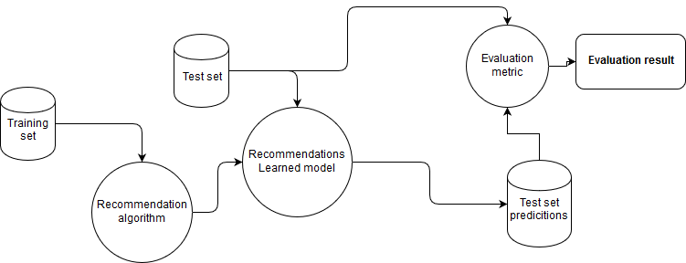
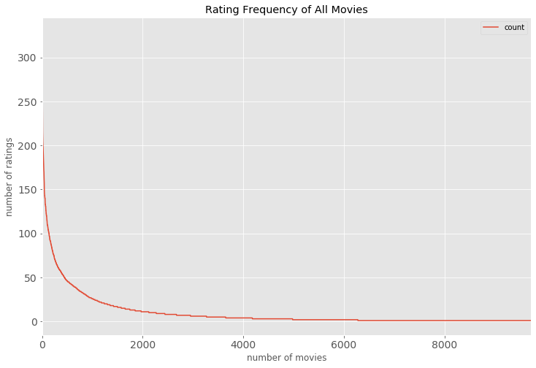
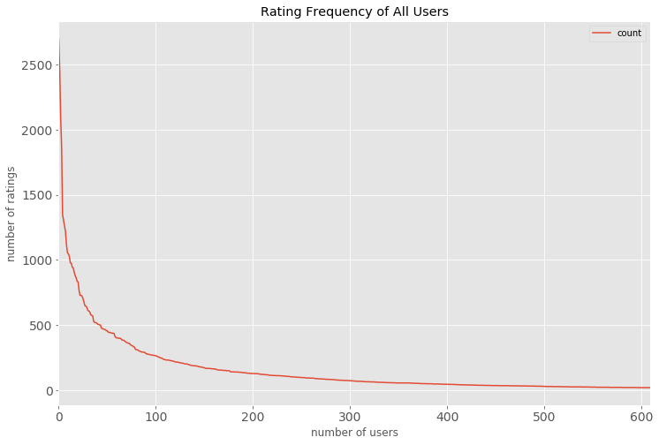
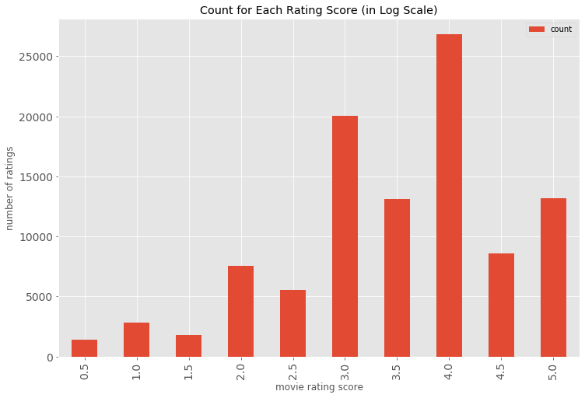

PRML Course Project Evaluation
Movie Recommendation System
Gautam 170010031
Swapnik 170010033
Ashrith 170010036
Indian Institute of Technology Dharwad
Computer Science and Engineeering
Email: 170010031@iitdh.ac.in
j
Abstract
Method
Results
A movie recommendation system, which gives recommendations to the user based on the tastes of the user and other users with similar tastes. Recommendation systems see widespread use in online shopping and streaming services like Amazon and Netflix to help users discover items that they would otherwise have not been able to find themselves.
1. KNN item-item collaborative filtering:
•Recommending movies based upon the similarity of rated items with k nearest neighbors in the dataset.
•Similarity criteria – cosine, Euclidean distance, Pearson correlation coefficient
2. KNN user-user collaborative filtering:
•Recommending movies based upon the similarity of users who rated an item with k nearest neighbors in the dataset.
•Similarity criteria – cosine, Euclidean distance, Pearson correlation coefficient
•Generally, poorer result compared to KNN item-item C
Algorithm | MAP Value
Item-Item CF | 0.37
User-user CF | 0.345
Introduction
Dataset Description: This dataset (ml-100k) describes 5-star rating and free-text tagging activity from MovieLens, a movie recommendation service. It contains 100836 ratings and 3683 tag applications across 9742 movies. These data were created by 610 users between March 29, 1996 and September 24, 2018. This dataset was generated on September 26, 2018.
Collaborative filtering:
item-item similarity
user-user similarity
item-item similarity using k-NN
user-user similarity using k-NN
Proposed Block Diagram
Data Visualisation
Conclusion
• We found that collaborative filtering performs better than content-based filtering in terms of
No. of ratings vs no. of movies
No. of ratings vs no. of users
Ratings vs. no. of users
Proposed Modeling Scheme
Training Phase :-
Acknowledgement
.
We would like to express our special thanks of gratitude to our PRML
Course Professor Mahadeva Prasanna for his able guidance and
support in completing our project.
We would also like to extend our gratitude to the teaching assistant
Mr. Jagabandu for his assistance.
References
Dataset: https://grouplens.org/datasets/movielens/
Reference:
https://towardsdatascience.com/recommendation-systems-models-and-evaluation-84944a84fb8e
https://towardsdatascience.com/evaluation-metrics-for-recommender-systems-df56c6611093
https://www.analyticsvidhya.com/blog/2018/06/comprehensive-guide-recommendation-engine-python/?
Evaluation
We use the Mean Average Precision @K (MAP@K) evaluation method to evaluate the performance of the Recommender System Models. K is the number of values we consider.
TP = True Positive
FP = False Positive
Notes:
1

